Slide 1


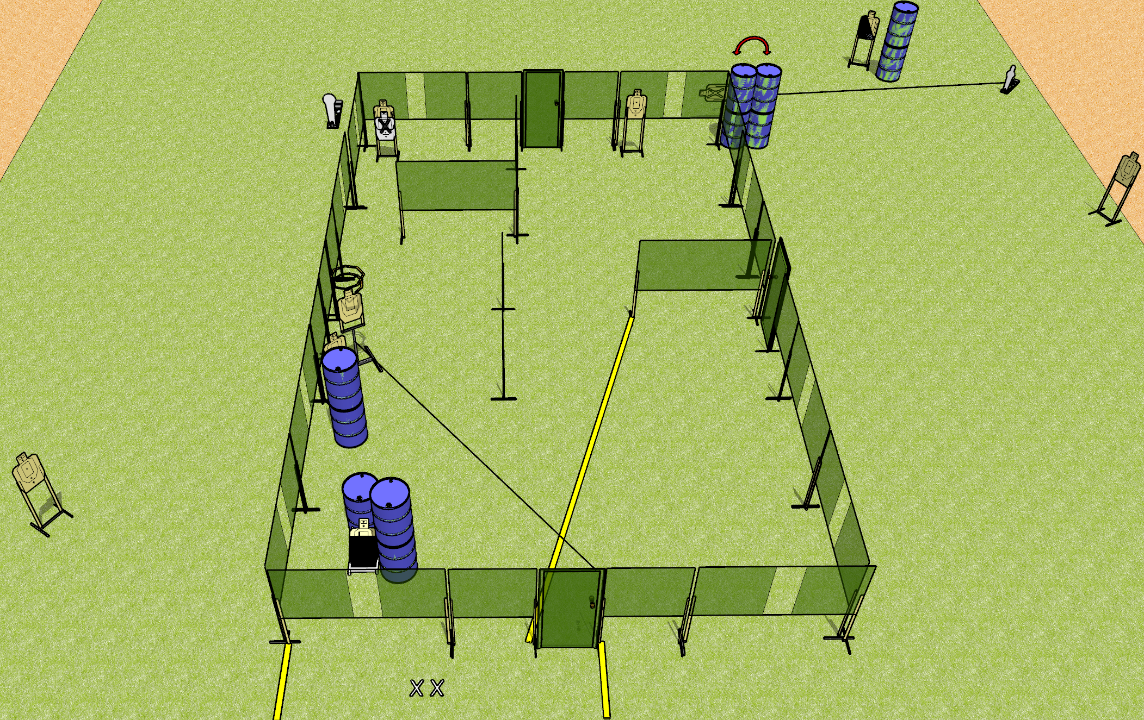
 | Dothan Gun Club – USPSA Match It’s Okay to Shoot These Walls Billy Course Designer : Drew Coleman
Round Count 20 rounds 9 paper 1 colt popper, 1 mini popper
Equipment List 4? Wall feet 1 action target, 1 diagonal Drop turner + activator Swinger + activator

Slide 2
It’s Okay to Shoot These Walls Billy
Written Stage Briefing
It’s Okay to Shoot These Walls Billy is a 20 round, 100 point, Comstock course of fire. There are 9 USPSA targets, 1 colt popper, and 1 mini popper. The best 2 hits on paper will score, and steel must fall to score. The start signal is audible.
All doors must be shut prior to the start signal.
The drop turner is activated by the door, and is a disappearing target. The swinger is activated by the mini popper, and is visible at rest.
Handgun start position is both feet on X’s, wrists below belt, handgun loaded and holstered.
PCC start position is both feet on X’s, stock on belt. Loaded carbine is held with both hands, safety on.
On start signal, engage targets as they become available from within the shooting area.

